Slide 1

Sarabpreet singh
MTECH (CSE)
Dept of CSE
ACET Amritsar

Slide 2

A graph G = (V,E) is composed of:
V: set of vertices
E: set of edges connecting the vertices in V
An edge e = (u,v) is a pair of vertices
Example:
a
b
V= {a,b,c,d,e}
E= {(a,b),(a,c),(a,d),
(b,e),(c,d),(c,e),
(d,e)}
c
d
e

Slide 3

electronic circuits
networks (roads, flights, communications)
CS16
JFK
LAX
LAX
STL
HNL
DFW
FTL

Slide 4

If (v0, v1) is an edge in an undirected graph,
  v0 and v1 are adjacent
  The edge (v0, v1) is incident on vertices v0 and v1
If <v0, v1> is an edge in a directed graph
  v0 is adjacent to v1, and v1 is adjacent from v0
  The edge <v0, v1> is incident on v0 and v1

Slide 5
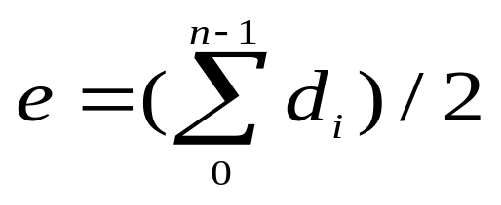


Terminology:
Degree of a Vertex
The degree of a vertex is the number of edges incident to that vertex
For directed graph,
  the in-degree of a vertex v is the number of edges
  that have v as the head
  the out-degree of a vertex v is the number of edges
  that have v as the tail
  if di is the degree of a vertex i in a graph G with n vertices and e edges, the number of edges is
Why? Since adjacent vertices each
count the adjoining edge, it will be
counted twice

Slide 6
Examples
0
3
2
0
1
2
3
3
3
1
2
3
3
4
5
6
G1
1
3
1
G2
1
1
3
0
in:1, out: 1
directed graph
in-degree
out-degree
1
in: 1, out: 2
2
in: 1, out: 0
G3

Slide 7

path: sequence of vertices v₁,v₂,. . .v_{k} such that consecutive vertices v_{i} and v_{i+1} are adjacent.
3
2
3
3
3
a
b
a
b
c
c
d
e
d
e
a b e d c
b e d c

Slide 8

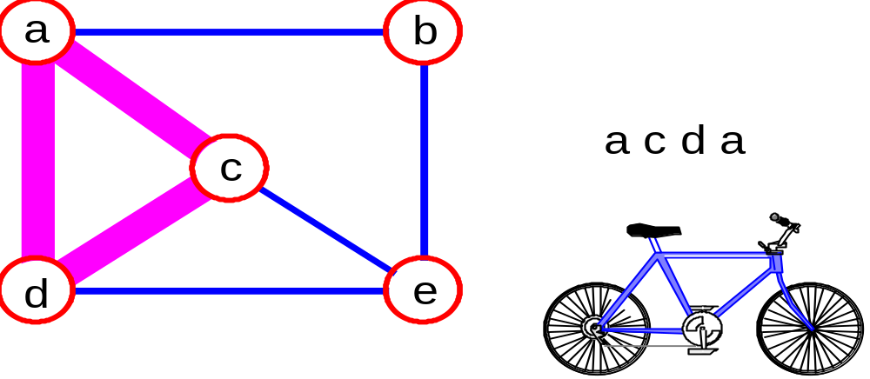
simple path: no repeated vertices
cycle: simple path, except that the last vertex is the same as the first vertex
a
b
b e c
c
d
e

Slide 9

connected graph: any two vertices are connected by some path
connected
not connected
subgraph: subset of vertices and edges forming a graph
connected component: maximal connected subgraph. E.g., the graph below has 3 connected components.

Slide 10
Subgraphs Examples
0
0
0
1
2
0
1
2
1
2
3
1
2
3
G1
(i) (ii) (iii) (iv)
(a) Some of the subgraph of G₁
3
0
0
0
0
0
1
1
1
1
2
2
2
(i) (ii) (iii) (iv)
(b) Some of the subgraph of G₃
G3

Slide 11

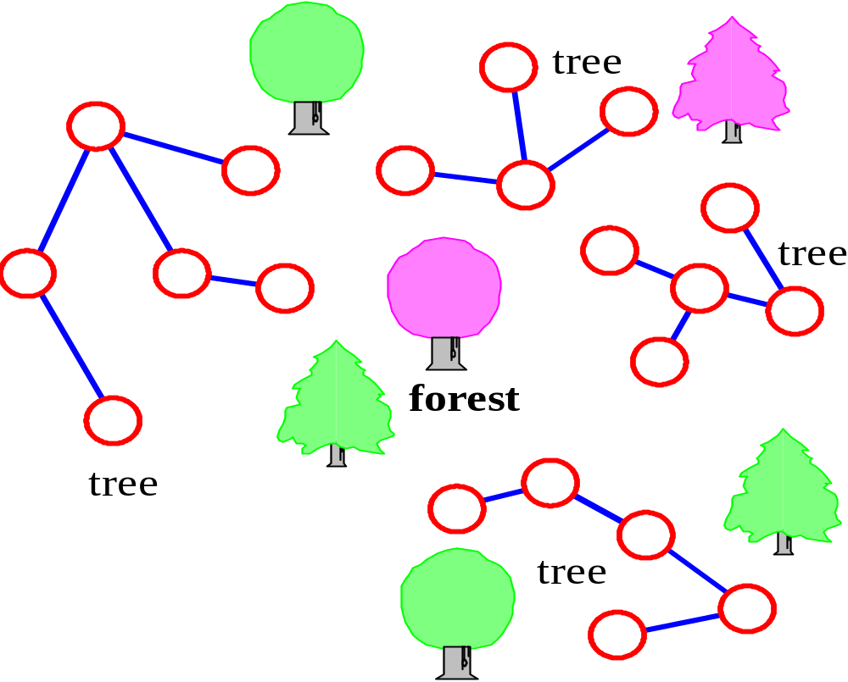
tree - connected graph without cycles
forest - collection of trees

Slide 12

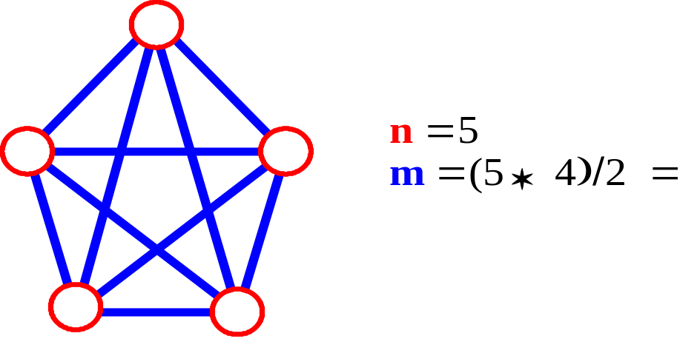
Let n = #vertices, and m = #edges
A complete graph: one in which all pairs of vertices are adjacent
How many total edges in a complete graph?
  Each of the n vertices is incident to n-1 edges, however, we would have counted each edge twice! Therefore, intuitively, m = n(n -1)/2.
Therefore, if a graph is not complete, m < n(n -1)/2

Slide 13

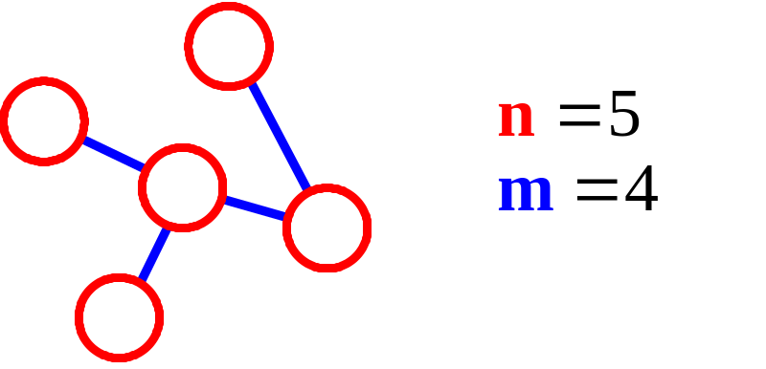
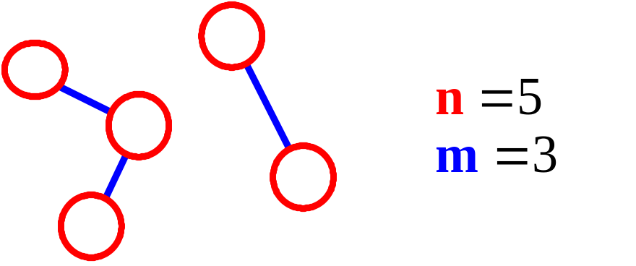
n = #vertices
m = #edges
For a tree m = n - 1
If m < n - 1, G is not connected

Slide 14

A graph where edges are directed

Slide 15

An undirected graph is one in which the pair of vertices in a edge is unordered, (v0, v1) = (v1,v0)
A directed graph is one in which each edge is a directed pair of vertices, <v0, v1> != <v1,v0>
tail
head

Slide 16
Graph Representations
Adjacency Matrix
Adjacency Lists

Slide 17
Adjacency Matrix
Let G=(V,E) be a graph with n vertices.
The adjacency matrix of G is a two-dimensional
n by n array, say adj_mat
If the edge (vi, vj) is in E(G), adj_mat[i][j]=1
If there is no such edge in E(G), adj_mat[i][j]=0
The adjacency matrix for an undirected graph is symmetric; the adjacency matrix for a digraph
need not be symmetric

Slide 18
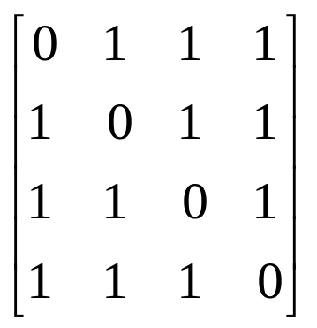
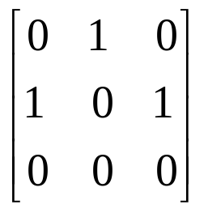
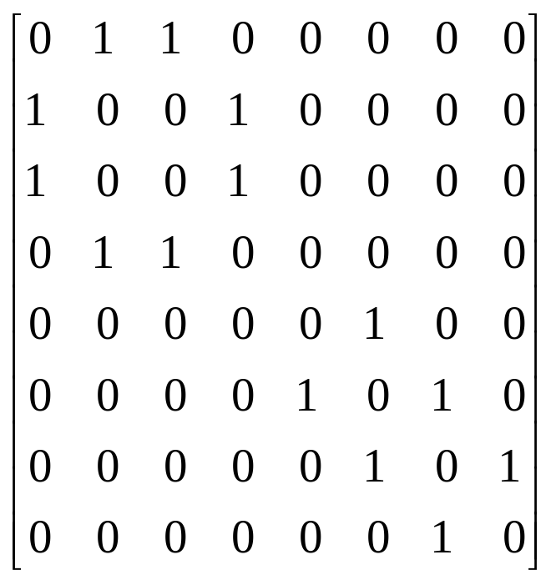
Examples for Adjacency Matrix
0
0
4
0
2
1
5
1
2
3
6
3
1
7
2
G2
G1
symmetric
undirected: n²/2
directed: n²
G4

Slide 19
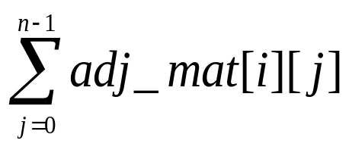
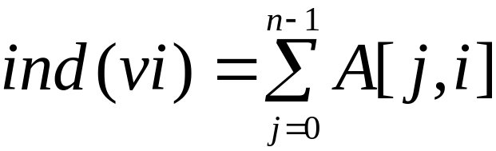

Merits of Adjacency Matrix
From the adjacency matrix, to determine the connection of vertices is easy
The degree of a vertex is
For a digraph (= directed graph), the row sum is the out_degree, while the column sum is the in_degree

Slide 20
0
0
4
2
1
5
1
2
3
6
3
7
0
1
2
3
1
2
3
0
1
2
3
4
5
6
7
1
2
0
2
3
0
3
0
1
3
0
3
0
1
2
1
2
G1
0
5
4
6
0
1
2
1
5
7
0
2
1
6
G3
G4
2
An undirected graph with n vertices and e edges ==> n head nodes and 2e list nodes

Slide 21

degree of a vertex in an undirected graph
  # of nodes in adjacency list
# of edges in a graph
  determined in O(n+e)
out-degree of a vertex in a directed graph
  # of nodes in its adjacency list
in-degree of a vertex in a directed graph
  traverse the whole data structure

Slide 22

2
3
3
2
2
3
1
S
S
S
2
1
1
2
2
3
3
Finished
Discovered
Undiscovered

Slide 23

Searching a graph:
  Systematically follow the edges of a graph
  to visit the vertices of the graph.
Used to discover the structure of a graph.
Standard graph-searching algorithms.
  Breadth-first Search (BFS).
  Depth-first Search (DFS).

Slide 24

Input: Graph G = (V, E), either directed or undirected,
and source vertex s ∈ V.
Output:
  d[v] = distance (smallest # of edges, or shortest path) from s to v, for all v ∈ V. d[v] = ∞ if v is not reachable from s.
  π[v] = u such that (u, v) is last edge on shortest path s v.
    u is v’s predecessor.
  Builds breadth-first tree with root s that contains all reachable vertices.
Definitions:
Path between vertices u and v: Sequence of vertices (v₁, v₂, …, v_{k}) such that u=v₁ and v =v_{k}, and (v_{i},v_{i+1}) ∈ E, for all 1≤ i ≤ k-1.
Length of the path: Number of edges in the path.
Path is simple if no vertex is repeated.
Error!

Slide 25
Expands the frontier between discovered and undiscovered vertices uniformly across the breadth of the frontier.
  A vertex is “discovered” the first time it is encountered during the search.
  A vertex is “finished” if all vertices adjacent to it have been discovered.
Colors the vertices to keep track of progress.
  White – Undiscovered.
  Gray – Discovered but not finished.
  Black – Finished.
    Colors are required only to reason about the algorithm. Can be implemented without colors.

Slide 26
BFS(G,s)
1. for each vertex u in V[G] – {s}
2 do color[u] ← white
3 d[u] ← ∝
4 π[u] ← nil
5 color[s] ← gray
6 d[s] ← 0
7 π[s] ← nil
8 Q ← Φ
9 enqueue(Q,s)
10 while Q ≠ Φ
11 do u ← dequeue(Q)
12 for each v in Adj[u]
13 do if color[v] = white
14 then color[v] ← gray
15 d[v] ← d[u] + 1
16 π[v] ← u
17 enqueue(Q,v)
18 color[u] ← black
white: undiscovered
gray: discovered
black: finished
Q: a queue of discovered vertices
color[v]: color of v
d[v]: distance from s to v
π[u]: predecessor of v
Example: animation.
Comp 122, Fall 2004

Slide 27

r
s
t
u
∞
0
∞
∞
∞
∞
∞
∞
v
w
x
y
Q: s
0

Slide 28
r
s
t
u
1
0
∞
∞
∞
1
∞
∞
v
w
x
y
Q: w r
1 1

Slide 29
r
s
t
u
1
0
2
∞
∞
1
2
∞
v
w
x
y
Q: r t x
1 2 2

Slide 30
r
s
t
u
1
0
2
∞
2
1
2
∞
v
w
x
y
Q: t x v
2 2 2

Slide 31
r
s
t
u
1
0
2
3
2
1
2
∞
v
w
x
y
Q: x v u
2 2 3

Slide 32
r
s
t
u
1
0
2
3
2
1
2
3
v
w
x
y
Q: v u y
2 3 3
Comp 122, Fall 2004

Slide 33
r
s
t
u
1
0
2
3
2
1
2
3
v
w
x
y
Q: u y
3 3
Comp 122, Fall 2004

Slide 34
r
s
t
u
1
0
2
3
2
1
2
3
v
w
x
y
Q: y
3
Comp 122, Fall 2004

Slide 35
r
s
t
u
1
0
2
3
2
1
2
3
v
w
x
y
Q: ∅
Comp 122, Fall 2004

Slide 36
r
s
t
u
1
0
2
3
2
1
2
3
v
w
x
y
BF Tree
Comp 122, Fall 2004

Slide 37

Explore edges out of the most recently discovered vertex v.
When all edges of v have been explored, backtrack to explore other edges leaving the vertex from which v was discovered (its predecessor).
“Search as deep as possible first.”
Continue until all vertices reachable from the original source are discovered.
If any undiscovered vertices remain, then one of them is chosen as a new source and search is repeated from that source.

Slide 38

Input: G = (V, E), directed or undirected. No source vertex given!
Output:
  2 timestamps on each vertex. Integers between 1 and 2|V|.
    d[v] = discovery time (v turns from white to gray)
    f [v] = finishing time (v turns from gray to black)
  π[v] : predecessor of v = u, such that v was discovered during the scan of u’s adjacency list.
Uses the same coloring scheme for vertices as BFS.
Comp 122, Fall 2004

Slide 39

DFS(G)
1. for each vertex u ∈ V[G]
2. do color[u] ← white
3. π[u] ← NIL
4. time ← 0
5. for each vertex u ∈ V[G]
6. do if color[u] = white
7. then DFS-Visit(u)
DFS-Visit(u)
color[u] ← GRAY ∇ White vertex u has been discovered
time ← time + 1
d[u] ← time
for each v ∈ Adj[u]
do if color[v] = WHITE
then π[v] ← u
DFS-Visit(v)
color[u] ← BLACK ∇ Blacken u; it is finished.
f[u] ← time ← time + 1
Uses a global timestamp time.
Example: animation.
Comp 122, Fall 2004

Slide 40

Tree edge: in the depth-first forest. Found by exploring (u, v).
Back edge: (u, v), where u is a descendant of v (in the depth-first tree).
Forward edge: (u, v), where v is a descendant of u, but not a tree edge.
Cross edge: any other edge. Can go between vertices in same depth-first tree or in different depth-first trees.
Theorem:
In DFS of an undirected graph, we get only tree and back edges. No forward or cross edges.
Comp 122, Fall 2004

Slide 41

u
v
w
1/
x
y
z
Comp 122, Fall 2004

Slide 42
u
v
w
1/
2/
x
y
z
Comp 122, Fall 2004

Slide 43
u
v
w
1/
2/
3/
x
y
z
Comp 122, Fall 2004

Slide 44
u
v
w
1/
2/
4/
3/
x
y
z
Comp 122, Fall 2004

Slide 45
u
v
w
1/
2/
B
4/
3/
x
y
z
Comp 122, Fall 2004

Slide 46
u
v
w
1/
2/
B
4/5
3/
x
y
z
Comp 122, Fall 2004

Slide 47
u
v
w
1/
2/
B
4/5
3/6
x
y
z
Comp 122, Fall 2004

Slide 48
u
v
w
1/
2/7
B
4/5
3/6
x
y
z
Comp 122, Fall 2004

Slide 49
u
v
w
1/
2/7
F
B
4/5
3/6
x
y
z
Comp 122, Fall 2004

Slide 50
u
v
w
1/8
2/7
F
B
4/5
3/6
x
y
z
Comp 122, Fall 2004

Slide 51
u
v
w
1/8
2/7
9/
F
B
4/5
3/6
x
y
z
Comp 122, Fall 2004

Slide 52
u
v
w
1/8
2/7
9/
F
B
C
4/5
3/6
x
y
z
Comp 122, Fall 2004

Slide 53
u
v
w
1/8
2/7
9/
F
B
C
4/5
3/6
10/
x
y
z
Comp 122, Fall 2004

Slide 54
u
v
w
1/8
2/7
9/
F
B
C
4/5
3/6
10/
B
x
y
z
Comp 122, Fall 2004

Slide 55
u
v
w
1/8
2/7
9/
F
B
C
4/5
3/6
10/11
B
x
y
z
Comp 122, Fall 2004

Slide 56
u
v
w
1/8
2/7
9/12
F
B
C
4/5
3/6
10/11
B
x
y
z
Comp 122, Fall 2004

Slide 57

Loops on lines 1-2 & 5-7 take Θ(V) time, excluding time to execute DFS-Visit.
DFS-Visit is called once for each white vertex v∈V when it’s painted gray the first time. Lines 3-6 of DFS-Visit is executed |Adj[v]| times. The total cost of executing DFS-Visit is ∑_{v∈V}|Adj[v]| = Θ(E)
Total running time of DFS is Θ(V+E).
Comp 122, Fall 2004

Slide 58

Theorem 22.7
For all u, v, exactly one of the following holds:
1. d[u] < f [u] < d[v] < f [v] or d[v] < f [v] < d[u] < f [u] and neither u nor v is a descendant of the other.
2. d[u] < d[v] < f [v] < f [u] and v is a descendant of u.
3. d[v] < d[u] < f [u] < f [v] and u is a descendant of v.
So d[u] < d[v] < f [u] < f [v] cannot happen.
Like parentheses:
  OK: ( ) [ ] ( [ ] ) [ ( ) ]
  Not OK: ( [ ) ] [ ( ] )
Corollary
v is a proper descendant of u if and only if d[u] < d[v] < f [v] < f [u].
Comp 122, Fall 2004

Slide 59

y
z
s
t
3/6
2/9
1/10
11/16
B
F
C
B
4/5
7/8
12/13
14/15
C
C
C
x
w
v
u
(s (z (y (x x) y) (w w) z) s) (t (v v) (u u) t)
Comp 122, Fall 2004

